Slide 1
Leading people through AI: roles, skills, adoption and change
What happens to my employees when AI arrives, and how do I bring them with me?
Leading with AI | Session 12 of the 15 (Sessions 0 to 14)
KLAi Professional Learning | Jotham Martin Wambi
Notes:
Welcome back. In Session 11 you mapped a workflow, chose for each step a rule, an AI step, an agent or a person, and put a value on the change. Every one of those steps is somebody’s work. Today is about those people: what happens to them, and how you bring them with you.
It is a practical session. We look at the evidence from banks, telecoms and public bodies, redesign one job together, and then you spend an hour on a plan for your own people.

Slide 2



What you will leave with today
By the end of today you will have
Redesign one role task by task, and say which tasks AI augments, automates or creates
Plan skills by level, answer the three common fears, and name your champions
Leave with a People and Skills Plan and an employee briefing for your first AI use, and the people column of your portfolio filled
Notes:
That question gives you three things to hold by the end. You will redesign one role task by task and say which tasks AI augments, automates or creates. You will plan skills by level, answer the three fears people hold, and name your champions. And you will leave with a People and Skills Plan and an employee briefing for your first AI use, with the people column of your portfolio filled in.

Slide 3
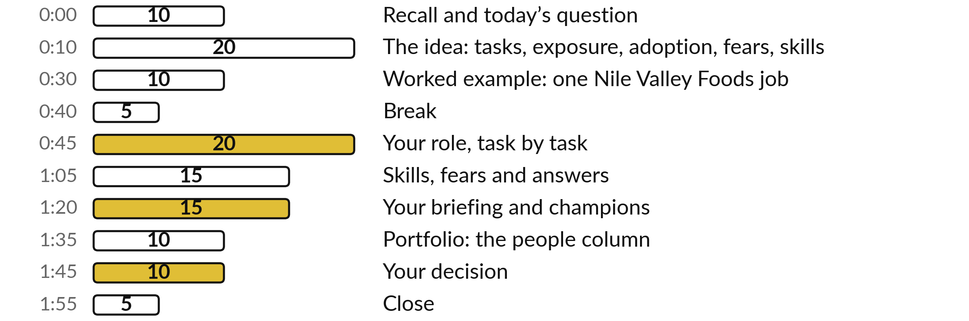
Your two hours: an hour of
it is your own people plan
We redesign one fictional job together; then you plan for your own people.
Notes:
Here is how the two hours run. Ten minutes to recall Session 11 and meet today’s question. Twenty minutes on the idea and the evidence: tasks, exposure, adoption, fears, skills and how to tell people. Ten minutes on a worked example, one Nile Valley Foods job redesigned task by task.
A five-minute break. Then a full hour on your own People and Skills Plan, in four blocks. Ten minutes for your decision, and five to close. First, three questions on last session.

Slide 4
Three questions from last time
1. In Session 11, what four choices did you have for each step of a workflow?
2. On the twelve customer messages, how did the rule and the AI compare?
3. How did you score your portfolio entries?
Answer aloud first. Then we check together.
Notes:
Three quick questions from Session 11. Answer aloud first, and then we check together.
Question one. In Session 11, what four choices did you have for each step of a workflow? Take a moment.
A good answer is this. A rule, an AI step, an agent, or a person. Many steps stay with a person, and an AI step usually has a person checking it.
Question two. On the twelve customer messages, how did the rule and the AI compare? Say it to yourself first.
A good answer is this. The keyword rule sent 7 of 12 to the right desk. The AI got 9 of 12 exactly right and 11 of 12 acceptable, and one wrong with confidence. Recorded, 4 November 2026.
Question three. How did you score your portfolio entries? Think about your own work as you answer.
A good answer is this. On value and on feasibility, each from 1 to 5, and added the two to rank them. Today you work on the one you ranked first.
If an answer was missing, last session’s take-away sheet has it.

Slide 5
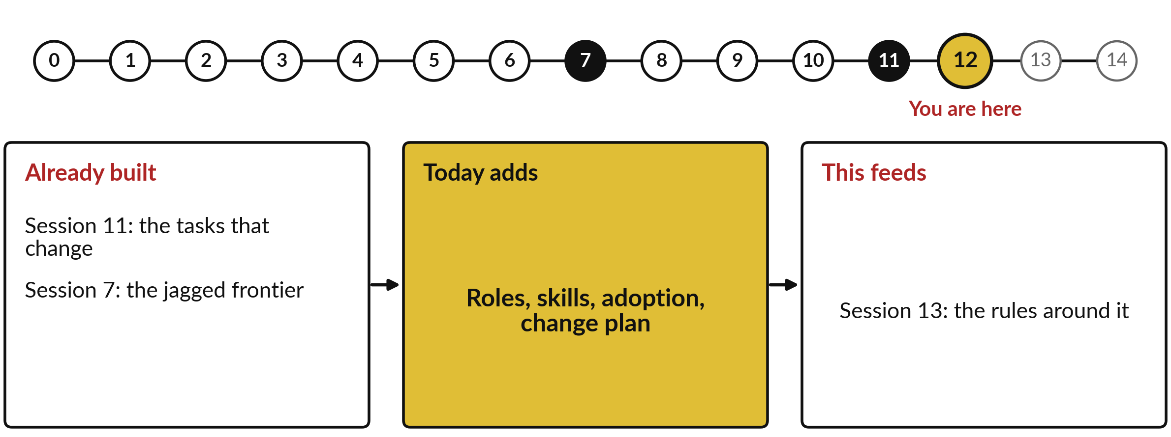
What today builds on, and where it leads
Each session is built on the ones before it.
Notes:
The dots along the top are the fifteen sessions, from the map at Session 0 to your plan at Session 14; the gold one is today.
Today uses the tasks that change from Session 11 and the jagged frontier from Session 7.
It adds roles, skills, adoption, change plan.
Session 13: the rules around it.

Slide 6
Words we use today
Word | What it means
Task | One piece of work inside a job, such as sorting messages or calling a customer back.
Exposure | How far AI can affect a job’s tasks. Exposed means affected; it does not mean lost.
Augment and automate | Augment: AI helps and a person decides. Automate: AI does the task and a person checks.
Adoption | How many people actually use a new tool in their daily work, and how often.
Champion | A trusted colleague who tries the tool first and helps the team use it well.
Reskilling | Training people for new tasks or a new role as their work changes.
Notes:
6 words for today. We use every one of them before the end of the session.
Task. One piece of work inside a job, such as sorting messages or calling a customer back.
Exposure. How far AI can affect a job’s tasks. Exposed means affected; it does not mean lost.
Augment and automate. Augment: AI helps and a person decides. Automate: AI does the task and a person checks.
Adoption. How many people actually use a new tool in their daily work, and how often.
Champion. A trusted colleague who tries the tool first and helps the team use it well.
Reskilling. Training people for new tasks or a new role as their work changes.

Slide 7
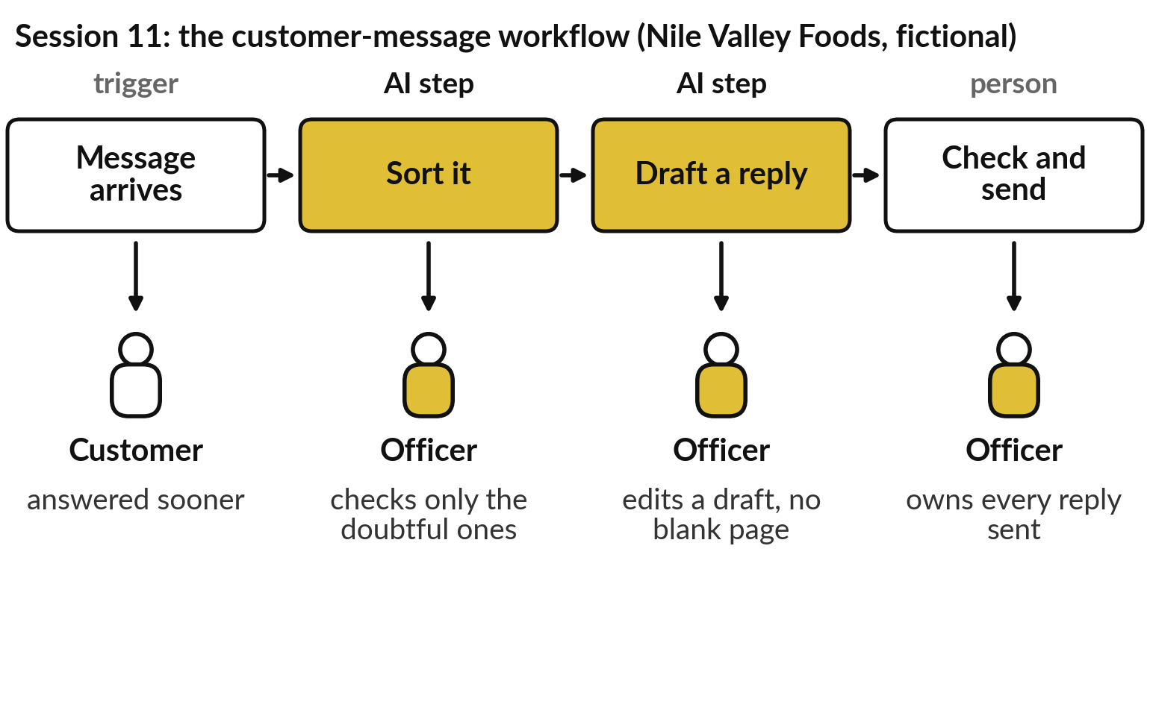
Every step you redesigned in Session
11 is somebody’s working day
A workflow map is also a map of people.
The officer checks and edits where the AI sorts and drafts.
Plan for the people before the tool arrives.
Notes:
Those six words point at something you already hold. Last session you mapped the customer-message workflow of Nile Valley Foods, our fictional distributor, and chose for each step a rule, an AI step, an agent or a person. Below each step is the person it touches. When the AI sorts, the customer service officer checks only the doubtful messages.
When the AI drafts, the officer edits instead of starting from a blank page. The agent still owns every reply that goes out. Every step that changes lands on someone’s working day. The map you drew is also a map of people, and an Australian bank found out what happens when a leader forgets that.

Slide 8
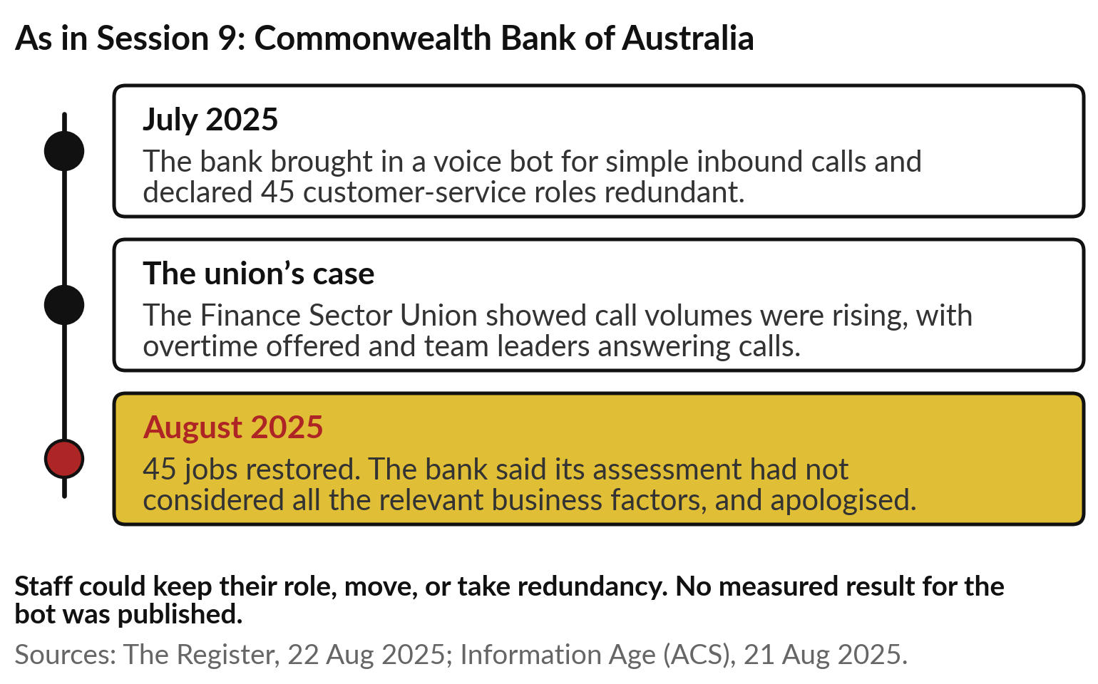
Commonwealth Bank cut 45 jobs for a voice
bot, then restored them with an apology
The bank decided about jobs before it understood the work.
The union saw the rising workload first.
The reversal cost trust, and a public apology.
Notes:
You met this case in Session 9, so I recall it in brief and add the people side. In July 2025 the Commonwealth Bank of Australia brought in a voice bot for simple inbound calls and declared 45 customer-service roles redundant. The Finance Sector Union showed that call volumes were rising, with overtime offered and team leaders answering calls.
In August the bank reversed the decision, said its assessment had not considered all the relevant business factors, and apologised. In Session 9 we read it as a failure of the decision around the AI. Today we read it as a failure of leading people: the bank decided about jobs before it understood the work, and the union saw the workload first.
Hence today’s question: what happens to your employees, and how do you bring them with you?

Slide 9
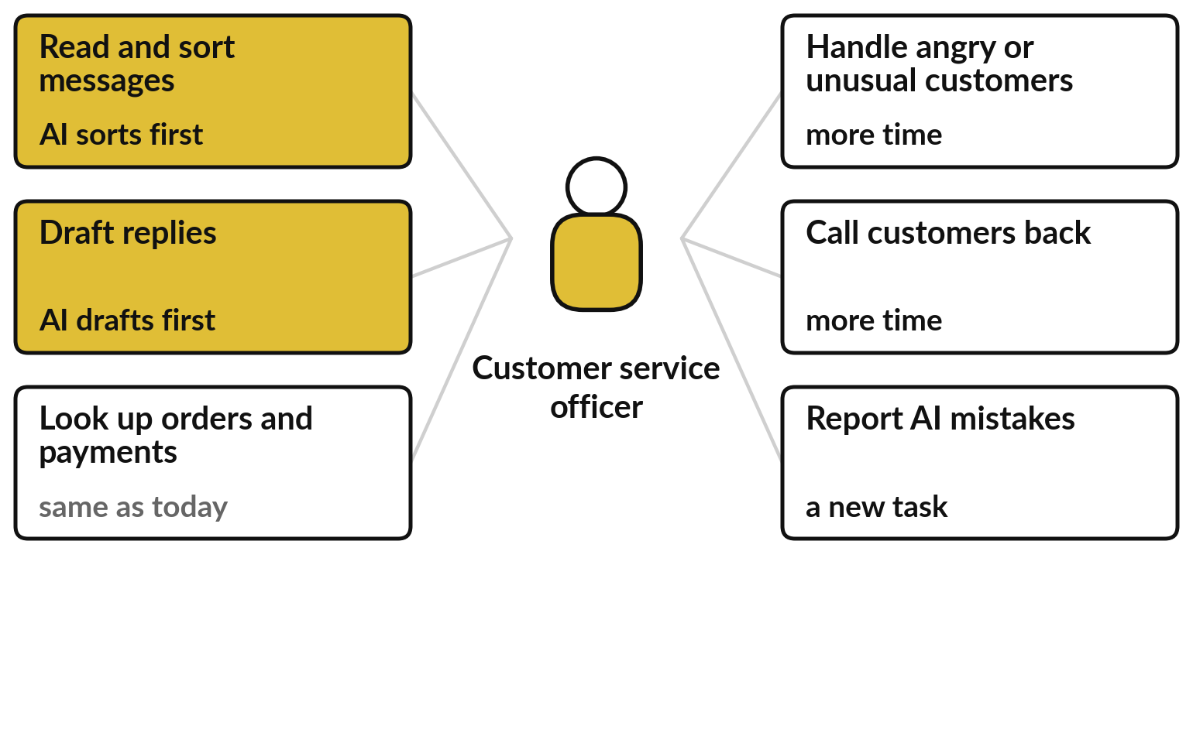
Tasks change before jobs do,
because a job is a bundle of tasks
Look at the tasks, one at a time, before you judge the job.
The AI takes part in two of six tasks.
Two tasks get more time, and one is new.
The job stays; its mix of tasks changes.
Notes:
The bank’s mistake shows the first idea: look at tasks before jobs. A job is a bundle of tasks, like a weekly timetable. Take the customer service officer at Nile Valley Foods, a person; I say officer so we do not confuse them with the AI agents of Session 10.
Six tasks. The AI takes part in two of them, sorting messages and drafting replies, shown in gold. Looking up orders stays the same. Handling angry or unusual customers and calling people back get more time, because time has been freed. And one task is new: reporting the AI’s mistakes.
The job is still there; its mix of tasks has changed. The People and Skills Plan therefore starts with the role, task by task, and each task can change in one of three ways.

Slide 10
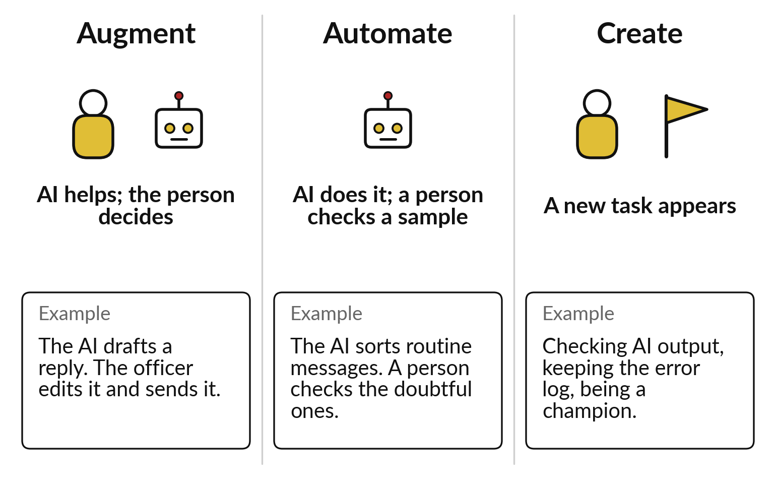
Exposed is not the same as lost: AI augments
a task, automates it, or creates a new one
Ask of every task which of the three it will be.
Most tasks in a frontline job are augmented first.
Automated tasks still need a person checking a sample.
Notes:
Those three ways have names. The first is augment: the AI helps and the person decides, as when it drafts a reply that the officer edits and sends. The second is automate: the AI does the task, and a person checks a sample or the doubtful cases, as with sorting routine messages.
The third is create: new tasks appear, such as checking AI output, keeping an error log or being a champion. When economists say a job is exposed to AI, they mean its tasks can be affected in one of these ways. Exposed means affected; it does not mean lost. Two international bodies have counted how many jobs are exposed.

Slide 11
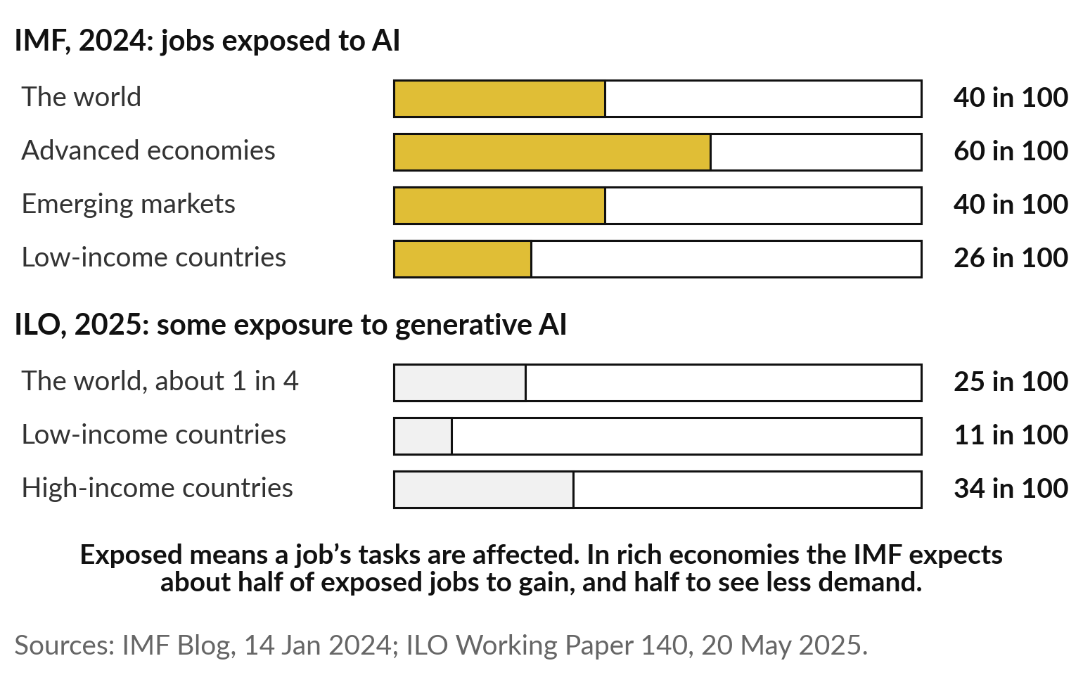
About 4 in 10 jobs worldwide are exposed to AI,
and fewer in low-income countries such as ours
Exposed means affected: some jobs gain, some see less demand.
Clerical jobs are the most exposed, and women hold many of them.
Lower exposure also means smaller gains.
Notes:
The IMF said in January 2024 that almost 40 in 100 jobs worldwide are exposed to AI: about 60 in advanced economies, 40 in emerging markets and 26 in low-income countries. In rich economies it expects about half of exposed jobs to gain and half to see less demand.
The ILO, in May 2025, found about 1 in 4 workers in a job with some exposure to generative AI, 11 in 100 in low-income countries and 34 in high-income ones. Clerical jobs are the most exposed, and women hold many of them. The ILO gave no figures for Africa, so I use low-income countries as the closest guide.
Lower exposure is no comfort either: it also means smaller gains. Employers, asked directly, add their own expectations.

Slide 12
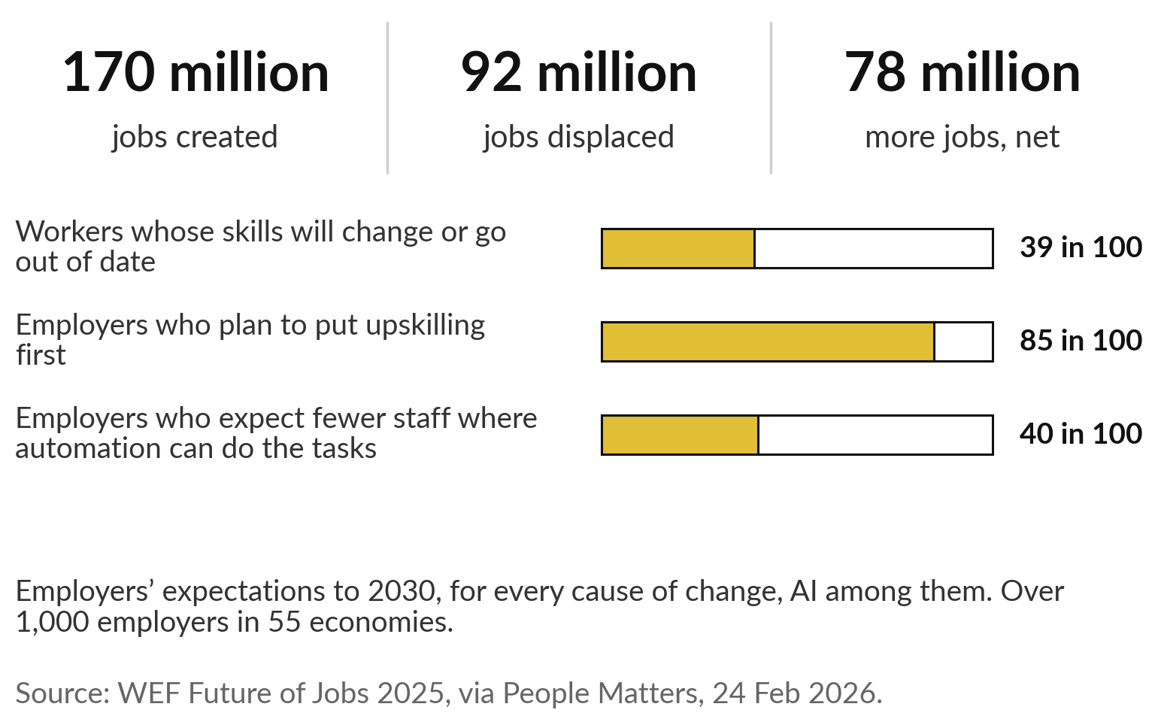
Employers expect jobs to be created and displaced at
once, and 39 in 100 workers’ skills to change by 2030
Both happen together: some roles grow, some shrink, most change.
These are expectations, for every cause of change.
Most employers plan to upskill first.
Notes:
The World Economic Forum asked over 1,000 large employers in 55 economies in January 2025. They expect 170 million jobs to be created and 92 million displaced by 2030, a net gain of 78 million. They expect 39 in 100 workers’ existing skills to change or go out of date.
85 in 100 plan to put upskilling first, and 40 in 100 expect to reduce staff where automation can do the tasks. Two cautions. These are employers’ expectations, covering every cause of change, AI among them. And I took the figures from news coverage, because the report page could not be opened.
For a leader the lesson is that roles grow and shrink at the same time, and the next tile shows where that is happening in our industries.

Slide 13
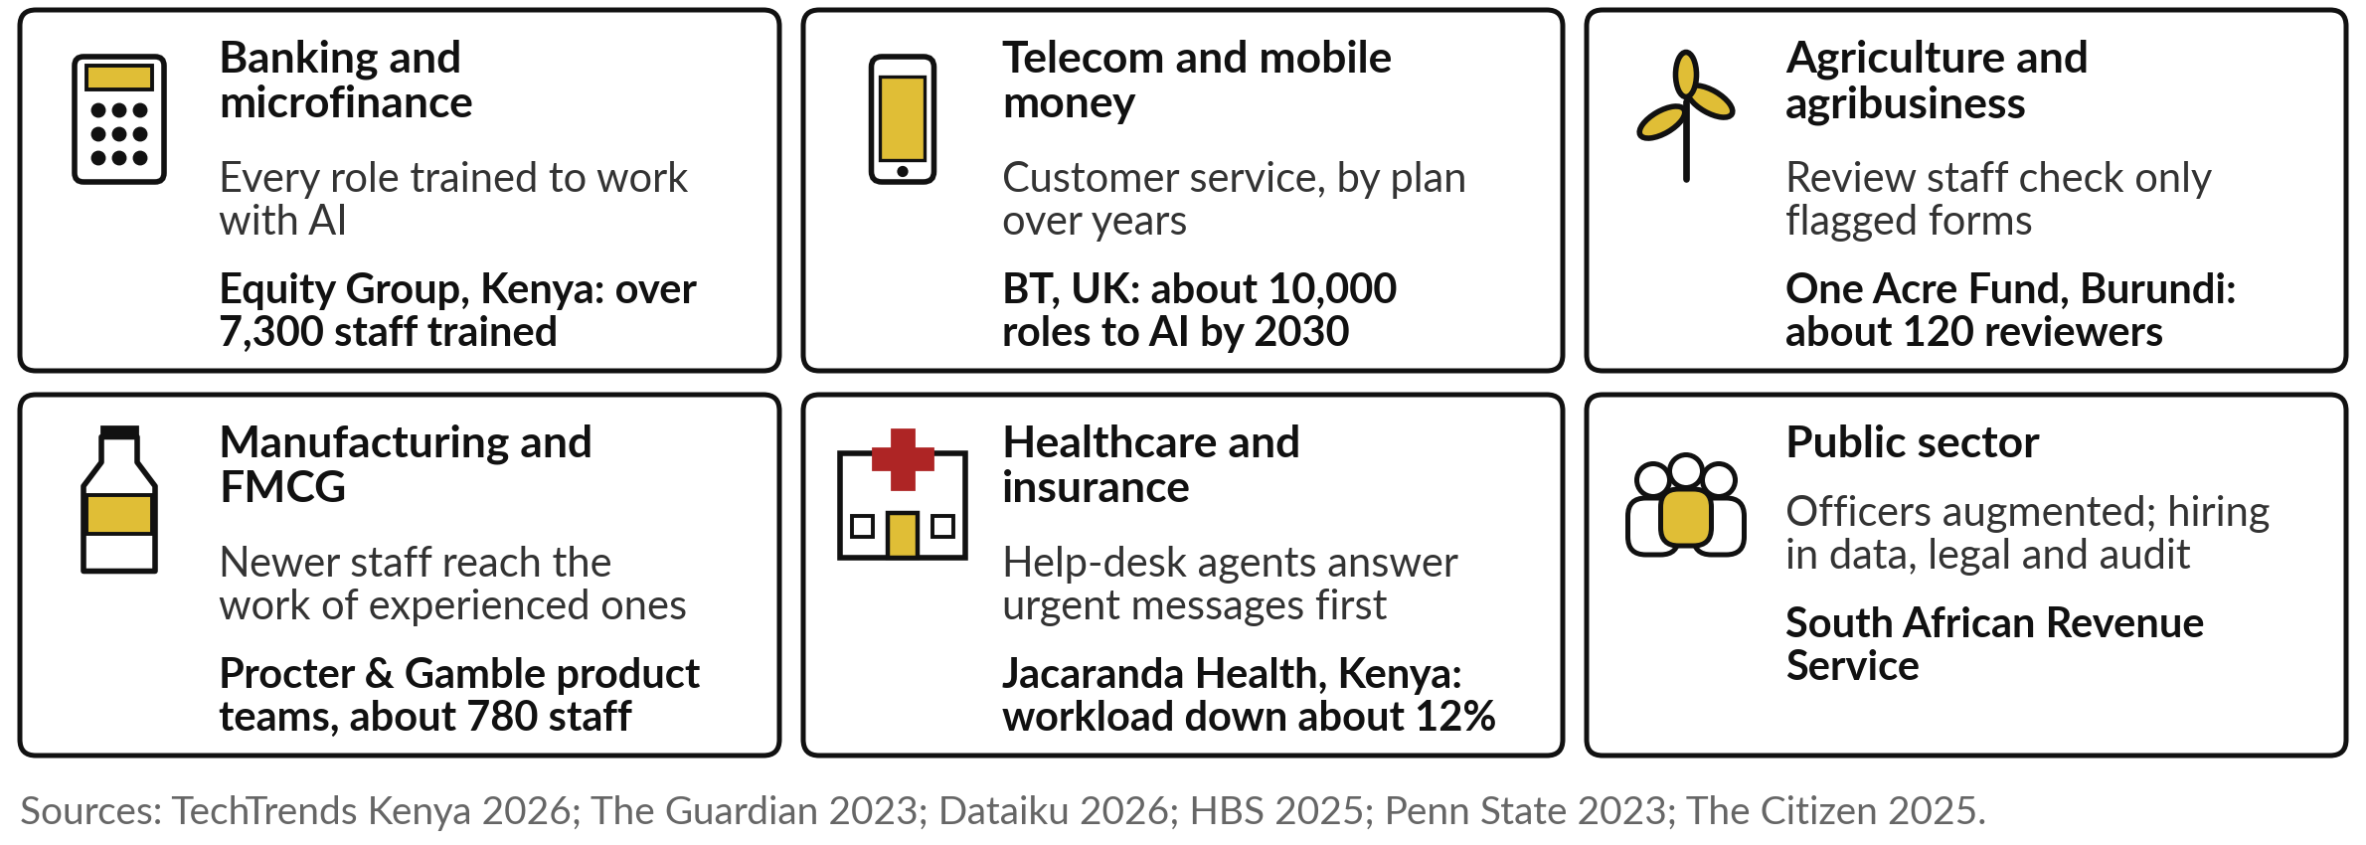
Equity trains every role, BT plans cuts, SARS
hires: six employers, six different routes
The Procter & Gamble result comes from an experiment, the One Acre Fund figure from a vendor.
Notes:
Across our six industries, employers are taking different routes with their people. In banking, Equity Group in Kenya trained over 7,300 staff to work with generative AI. In telecom, BT in Britain planned to replace about 10,000 roles with AI by 2030, mainly in customer service. In agriculture, One Acre Fund in Burundi has about 120 review staff who now look only at the farm forms the software flags; that is a vendor’s story.
In FMCG, a Procter and Gamble experiment found newer staff with AI performing like experienced colleagues. In health, Jacaranda Health’s help desk answers urgent messages from mothers first. And the South African Revenue Service says AI augments its officers while it hires in data, legal and audit. Find your tile, then compare two companies that went in opposite directions.

Slide 14
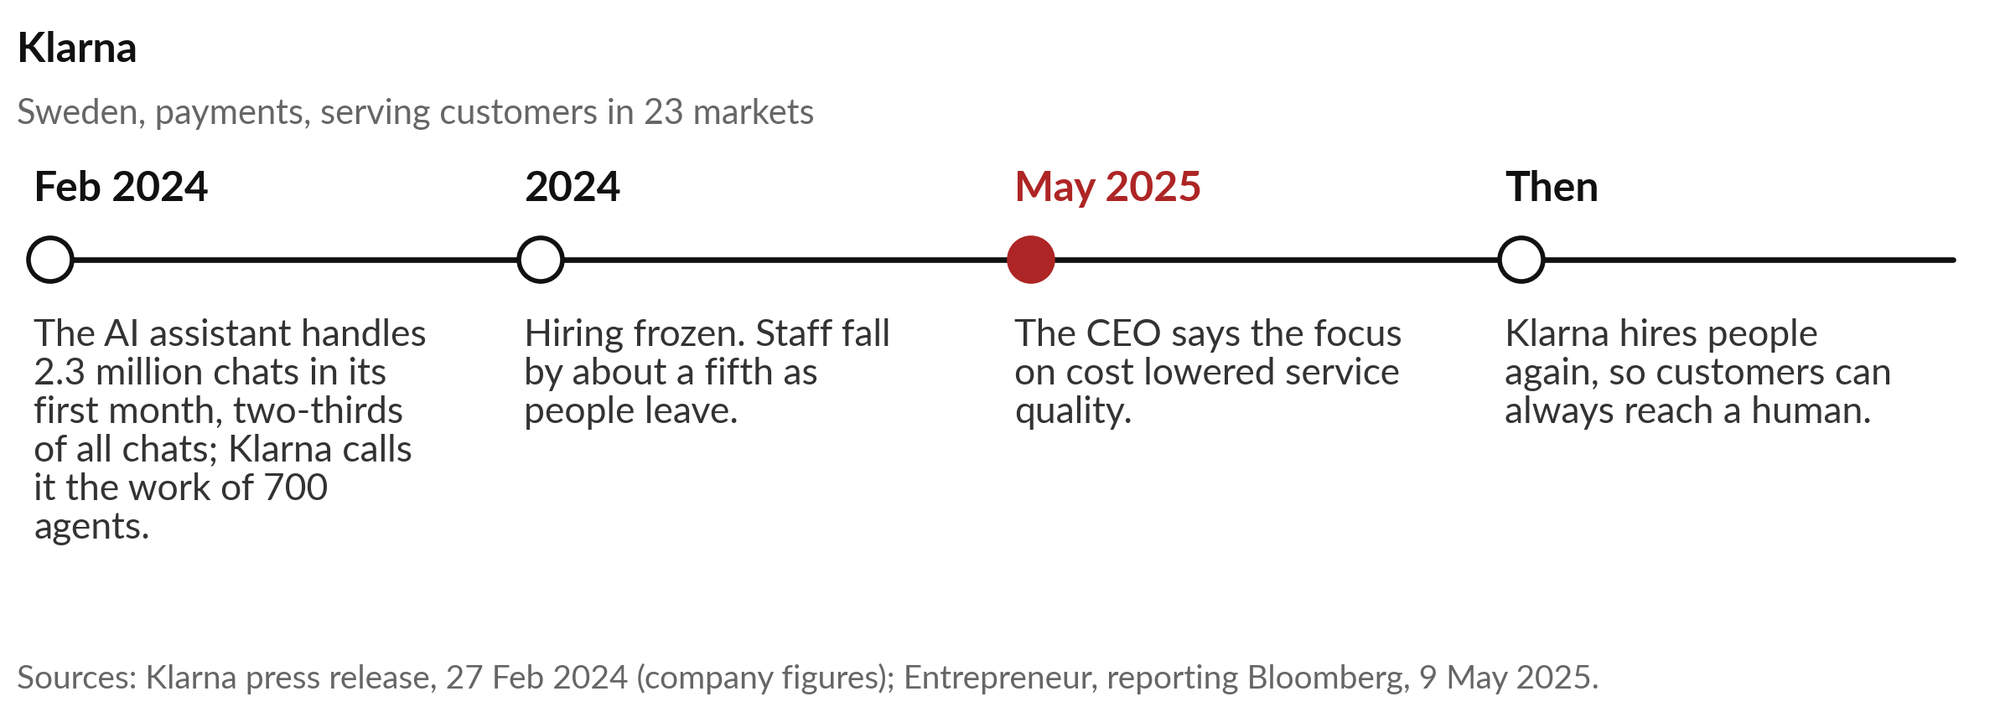
Klarna let AI take two-thirds of its
customer chats, then hired people back
Automating a task is easy to count. The quality customers feel is harder.
Notes:
Klarna pushed automation hard, and you saw it on the banking tile of Session 5. The company, the Swedish payments company, answers customer chats with an AI assistant. In February 2024 it said the assistant handled 2.3 million conversations in its first month, two-thirds of all its service chats, which it called the work of 700 full-time agents.
Those are the company’s own one-month figures. It froze hiring and let staff numbers fall as people left. Then, in May 2025, the chief executive told Bloomberg that the focus on cost had lowered the quality of service, and Klarna began recruiting people again so customers can always reach a human.
Cost per chat is one measure; the quality customers feel is another. Equity Group took the opposite route.

Slide 15
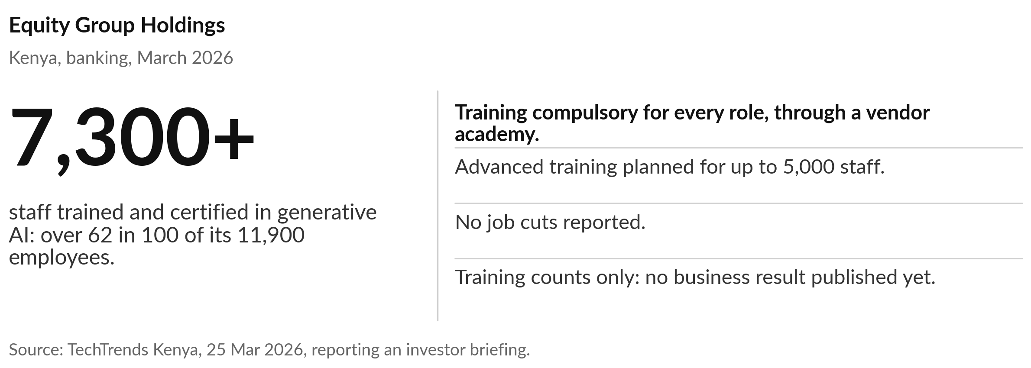
Equity Group made AI training compulsory for
every role before the tools reached customers
A vendor certificate shows who attended; skill shows in the work.
Notes:
The opposite route is closer to home. Equity Group in Kenya says it is moving AI into customer engagement, risk and operations, and it made AI training compulsory for staff in every role. By March 2026 over 7,300 employees, more than 62 in 100 of its 11,900 staff, had been trained and certified in generative AI through the Huawei ICT Academy, with advanced training planned for up to 5,000.
No job cuts were reported. The chief executive, James Mwangi, said staff cannot be placed in an AI-driven organisation without the skills to work in it. These are training counts with no business result yet, and a vendor certificate is no measure of skill. Your staff will also read much bigger announcements.

Slide 16
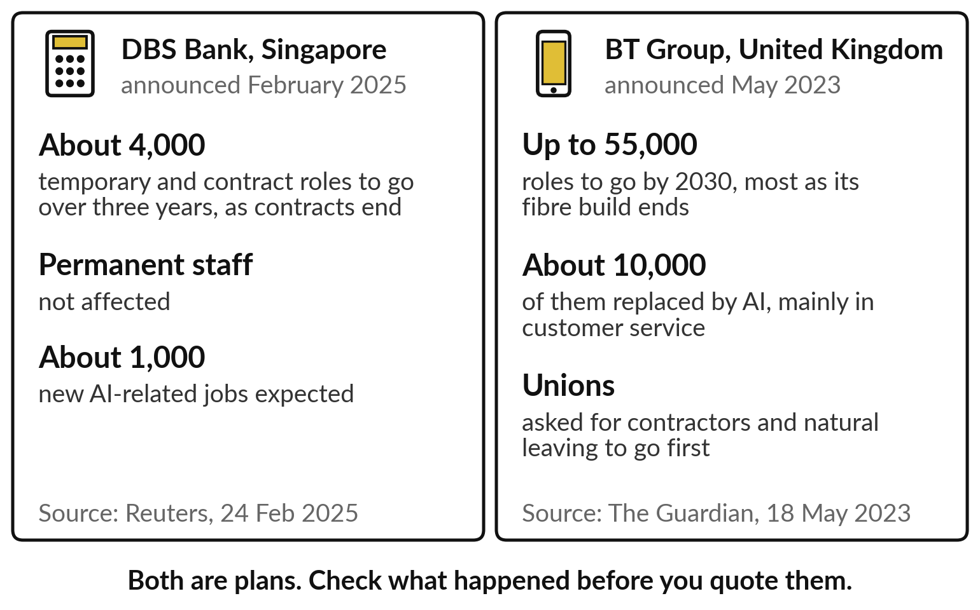
When big employers announce cuts, they are plans over
years, mostly through contracts ending and people leaving
Read an announcement for who carries the change, and how fast.
Contractors carry much of the change.
Both are plans: check progress before you quote them.
Notes:
You will see headlines like these, and so will your staff. In February 2025 DBS Bank in Singapore said about 4,000 temporary and contract roles would go over three years as contracts end, with permanent staff not affected and about 1,000 new AI-related jobs expected. In May 2023 BT in Britain said it would cut up to 55,000 roles by 2030, about 10,000 of them replaced by AI, mainly in customer service; its unions asked for subcontractors and natural leaving to go first.
Both are plans, spread over years; contractors carry much of the change; and people leaving on their own does the rest. Check progress before quoting either. Announcements aside, people take up a new tool in a pattern you can predict.

Slide 17
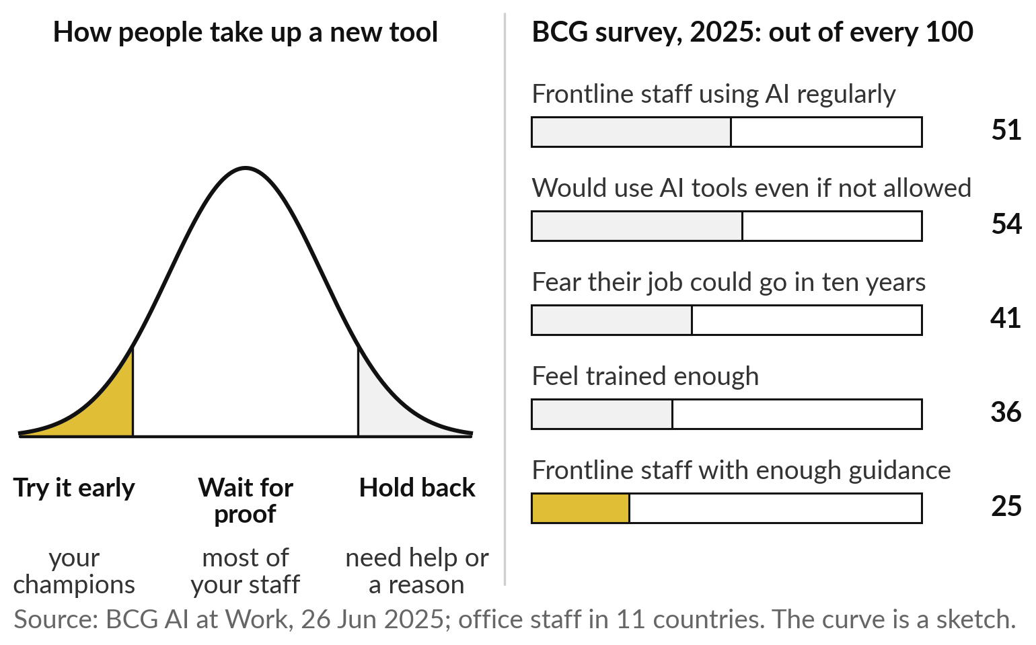
Adoption follows a curve, and on the
front line it has stalled at about half
A few try it early, most wait for proof, some hold back.
Your early users become your champions.
Without guidance, use goes into hiding.
Notes:
When a new tool arrives, people take it up along a curve. A few try it early: they become your champions. Most wait for proof that it helps and is allowed. Some hold back, out of fear or because the tool does not fit their work. BCG surveyed over 10,600 office staff in 11 countries in 2025.
Regular use among frontline staff had stalled at 51 in 100. 54 in 100 of all staff said they would use AI tools even if not allowed: the shadow AI we met in Session 0. Only 36 felt trained enough, and only 25 in 100 frontline staff said leaders gave enough guidance.
And 41 in 100 feared their job could go within ten years. Fear is where we turn next.

Slide 18
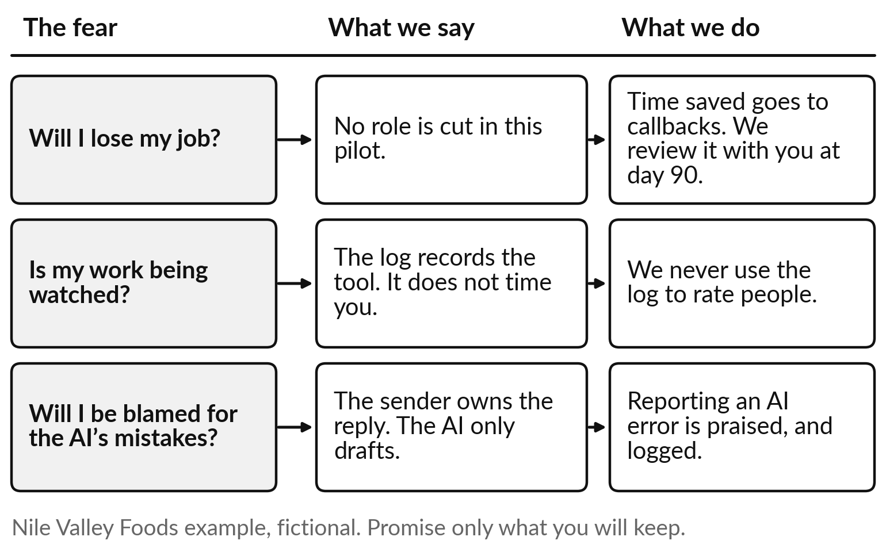
Answer three fears out loud: losing
my job, being watched, being blamed
Say what will happen, then do what you said.
Fear hides use and good ideas.
Promise only what you will keep.
Notes:
Three fears come up in almost every team. Will I lose my job?
Is my work being watched?
Will I be blamed for the AI’s mistakes?
Each needs an answer you say, and an action that proves it. At Nile Valley Foods: no role is cut in this pilot, the time saved goes to the backlog of customer callbacks, and the team reviews it at day ninety. The log records the tool and is never used to rate people.
The person who sends a reply owns it, the AI only drafts, and reporting an AI error is praised. Promise only what you will keep, and decide nothing about jobs before you understand the work, as Commonwealth Bank learned. Once people feel safe, they need skills.

Slide 19
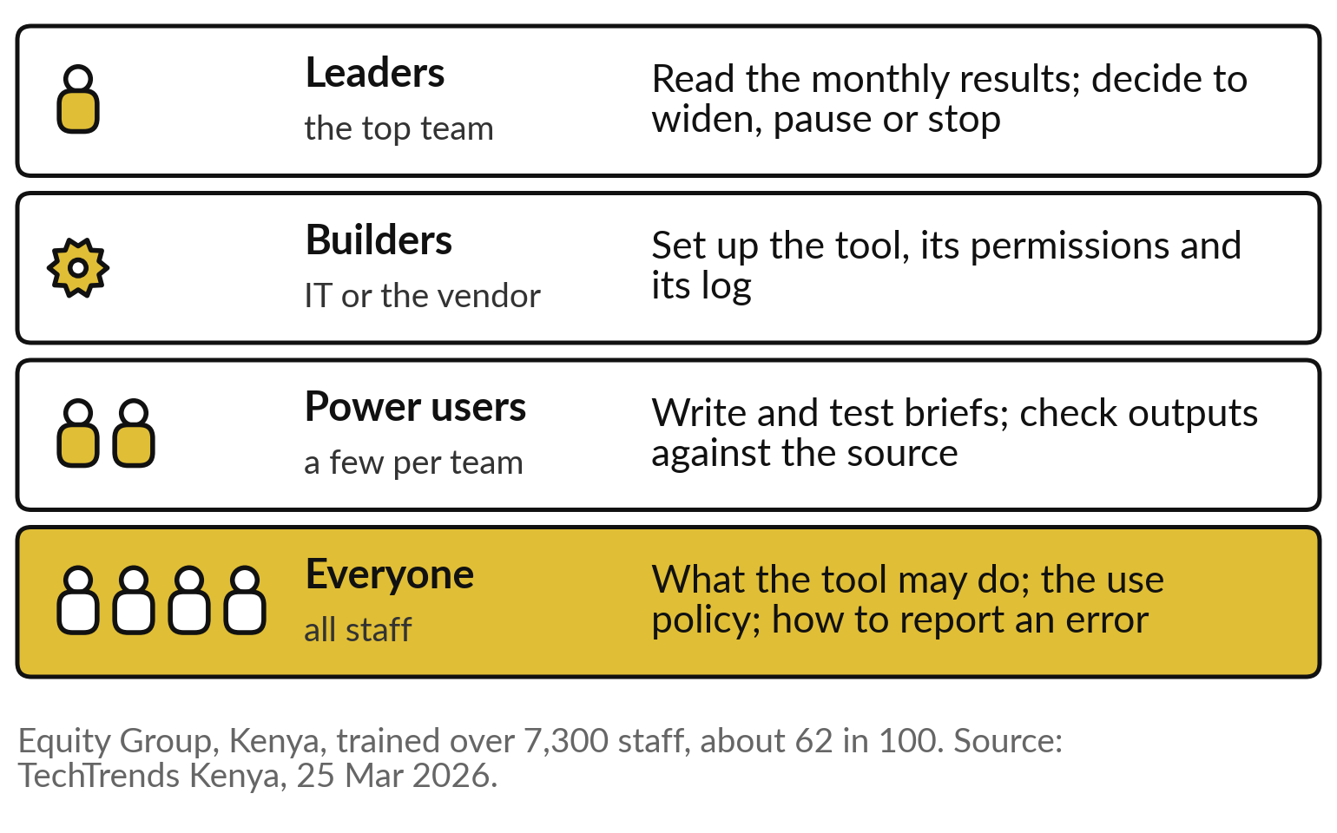
Everyone learns the basics, a few go
deep, and leaders learn to read the results
Train the whole team in the basics before training anyone deeply.
Pledges count training reach, which is not the same as use at work.
Notes:
Skills come in four levels. Everyone needs the basics: what the tool may and may not do, the use policy, and how to report an error. Power users, a few in each team, learn to write and test briefs, to check outputs against the source, and to know where the tool is strong and weak: the jagged frontier of Session 7.
Builders, usually IT or the vendor, set up the tool, its permissions and its log, the least privilege of Session 10. And leaders learn to read the monthly results and decide to widen, pause or stop. Equity trained everyone first. National pledges such as Microsoft’s in Kenya count training reach, which is not the same as use at work.
Skills are half of it; the other half is what you say.

Slide 20
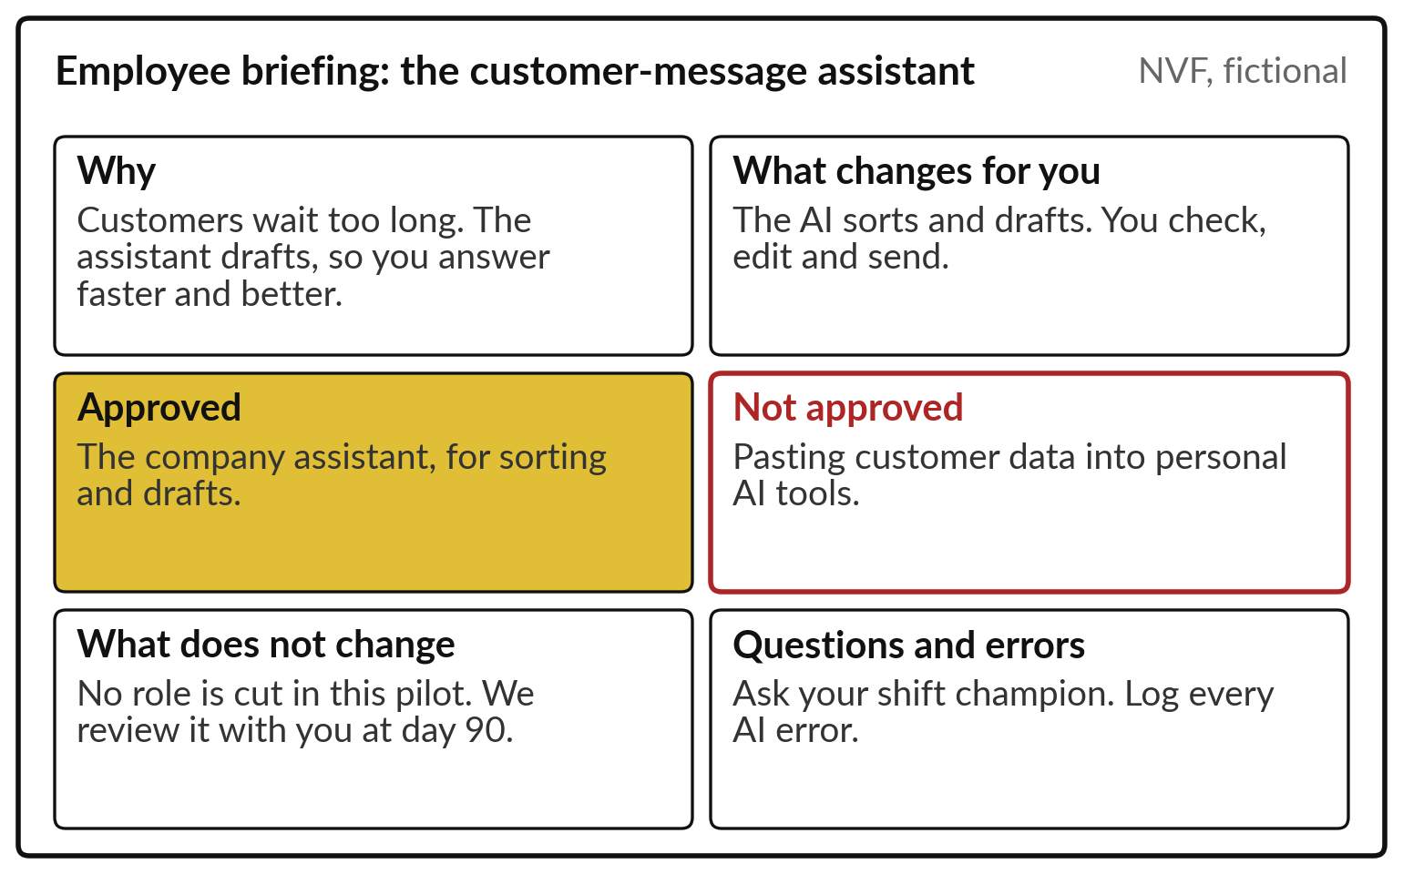
Tell people the why, what is approved
and what is not, before the tool arrives
One page, said aloud by the leader, then pinned up.
Naming what is not approved also protects staff under the Data Protection and Privacy Act.
Notes:
What you say fits on one page, the employee briefing, and you say it yourself before the tool arrives. The Nile Valley Foods version reads like this. Why: customers wait too long, and the assistant drafts so you answer faster and better. What changes for you: the AI sorts and drafts, you check, edit and send.
Approved: the company assistant for sorting and drafts. Not approved: pasting customer data into personal AI tools, which also protects you under the Data Protection and Privacy Act. What does not change: no role is cut in this pilot. And where to ask and how to report an error.
An American company showed what happens when a memo skips the why.

Slide 21
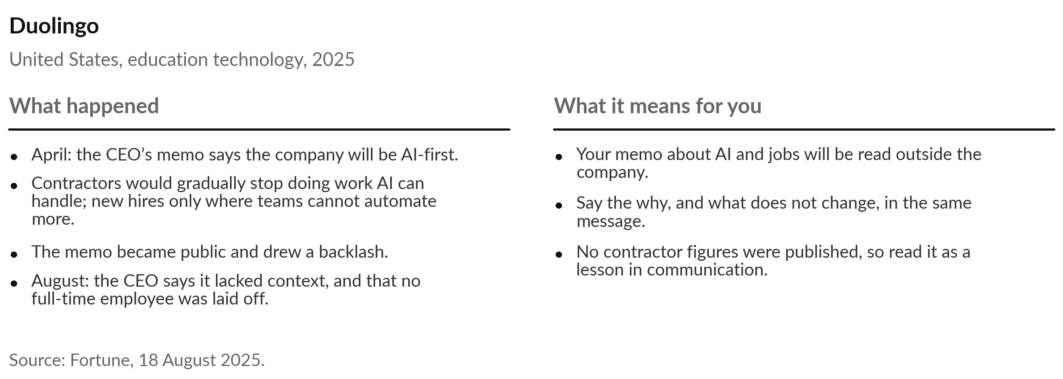
Duolingo’s AI-first memo, sent without
context, became a public problem
Internal messages about AI and jobs travel outside. Write them for both audiences.
Notes:
Duolingo shows what happens without that briefing. In April 2025 the education company’s chief executive sent staff a memo saying it would become AI-first: contractors would gradually stop doing work AI can handle, and new staff would be hired only where teams could not automate more. The memo became public and drew a backlash.
In August the chief executive told the New York Times that the memo had not given enough context, and that the company had never laid off full-time employees and did not plan to. No figures on contractors were published, so treat this as a communication case. Your memo about AI and jobs will be read outside your company. Inside it, you need people to carry the message.

Slide 22
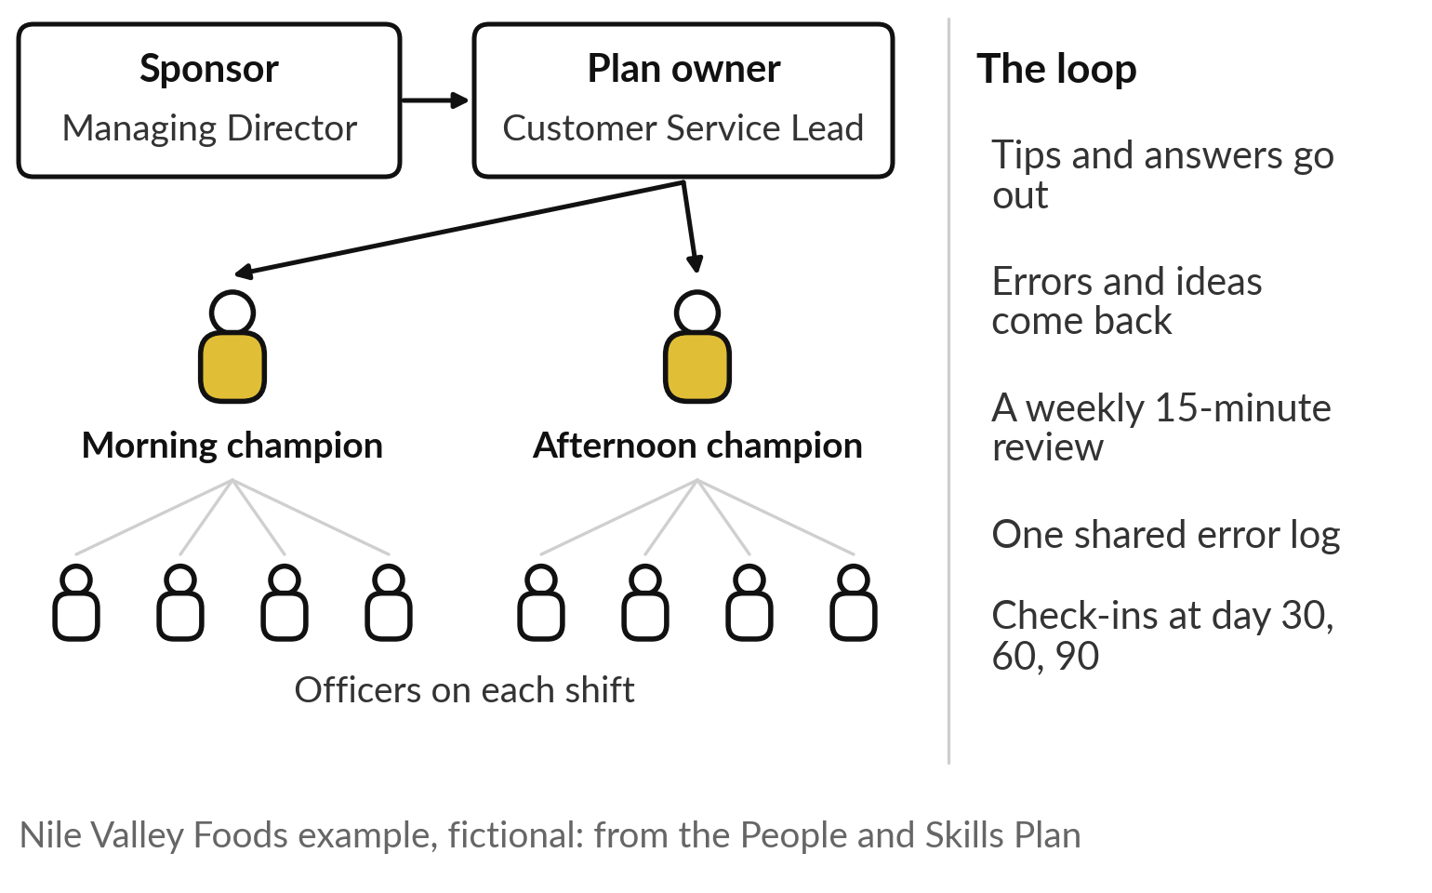
Champions on every shift turn
one briefing into daily habits
Champions are the early users from the curve, given a role.
One per shift or branch, chosen for trust.
A weekly review and one shared error log.
Check-ins at day 30, 60 and 90.
Notes:
Champions carry it. Remember the early users on the adoption curve. Give them a role. At Nile Valley Foods the sponsor is the Managing Director and the plan owner is the Customer Service Lead. Two officers who tried the assistant first become champions, one on each shift. Tips and answers go out through them; errors and ideas come back through them to a weekly fifteen-minute review and one shared error log.
Then check-ins at day thirty, sixty and ninety, with the Follow-up Kit. Choose champions for trust more than for technical skill: people follow colleagues they believe. Before we redesign a job together, take six questions to your HR lead.

Slide 23
Before announcing any AI change, ask HR
who carries it and what you can promise
Ask | Why it matters
Which tasks change in each role, and by how much? | Jobs change task by task
Who carries the change: staff, contractors, new hires? | Contractors are often hit first and told last
What do we promise, and can we keep it? | A broken promise costs more than the tool saves
What training does each level need, and when? | Only 36 in 100 staff feel trained enough
Who are our champions, and do they have time? | Adoption stalls without guidance
How will staff report errors without blame? | Hidden errors become customer problems
Notes:
Everything so far comes down to six questions for your HR lead and your managers. Which tasks change in each role, and by how much?
Who carries the change: permanent staff, contractors or new hires?
Contractors are often hit first and told last, as DBS and BT show. What do we promise, and can we keep it?
What training does each level need, and when, given that only 36 in 100 staff feel trained enough?
Who are our champions, and have we given them time?
And how will staff report errors without blame?
Put these to your team this week. We answer the first one together, for one job.

Slide 24
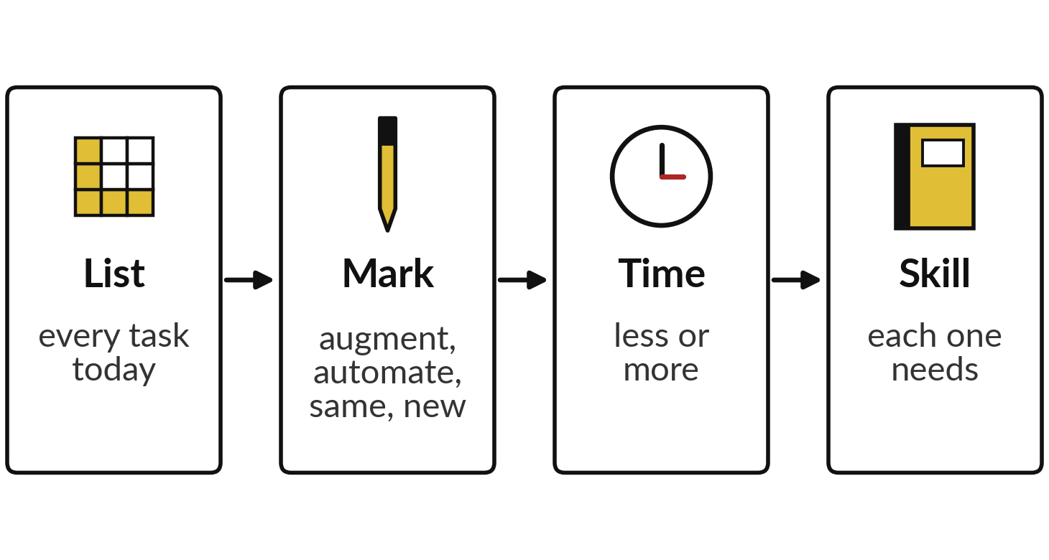
We redesign one Nile Valley
Foods job together, task by task
I will show
Watch for
Which tasks the AI takes part in
Where the freed time goes
The new task nobody had before
Notes:
Now we do it together, live, on one job. Nobody runs an AI tool here; this is your judgement and mine. The job is the customer service officer at Nile Valley Foods, our fictional distributor, the person whose day we saw change on the first slide. We follow four steps: list every task done today, mark each as augmented, automated, unchanged or new, say whether time on it goes up or down, and name the skill each one needs.
Watch for three things: the tasks the AI takes part in, where the freed time goes, and the new task nobody did before. Call out the tasks as you would see them in your own customer desk.

Slide 25
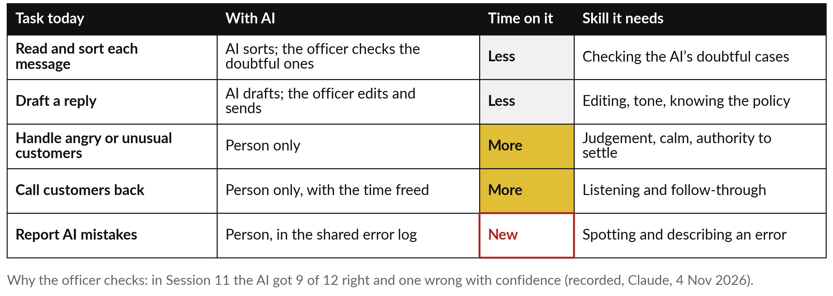
The officer sorts and drafts less, and
spends more time on difficult customers
Nile Valley Foods is fictional. This is the first part of the People and Skills Plan.
Notes:
This is the job as we built it. Reading and sorting each message: the AI sorts, and the officer checks the doubtful ones, so less time. Drafting a reply: the AI drafts, the officer edits and sends, less time again, with a new skill in editing and tone.
Handling angry or unusual customers stays with the person, and gets more time. Calling customers back gets the time freed. And a new task: reporting the AI’s mistakes in the shared error log. Why keep the officer checking?
Because in Session 11, on the twelve recorded messages, the AI got 9 exactly right and one wrong with confidence. The person catches that one, and you will know desks where the list would differ.

Slide 26
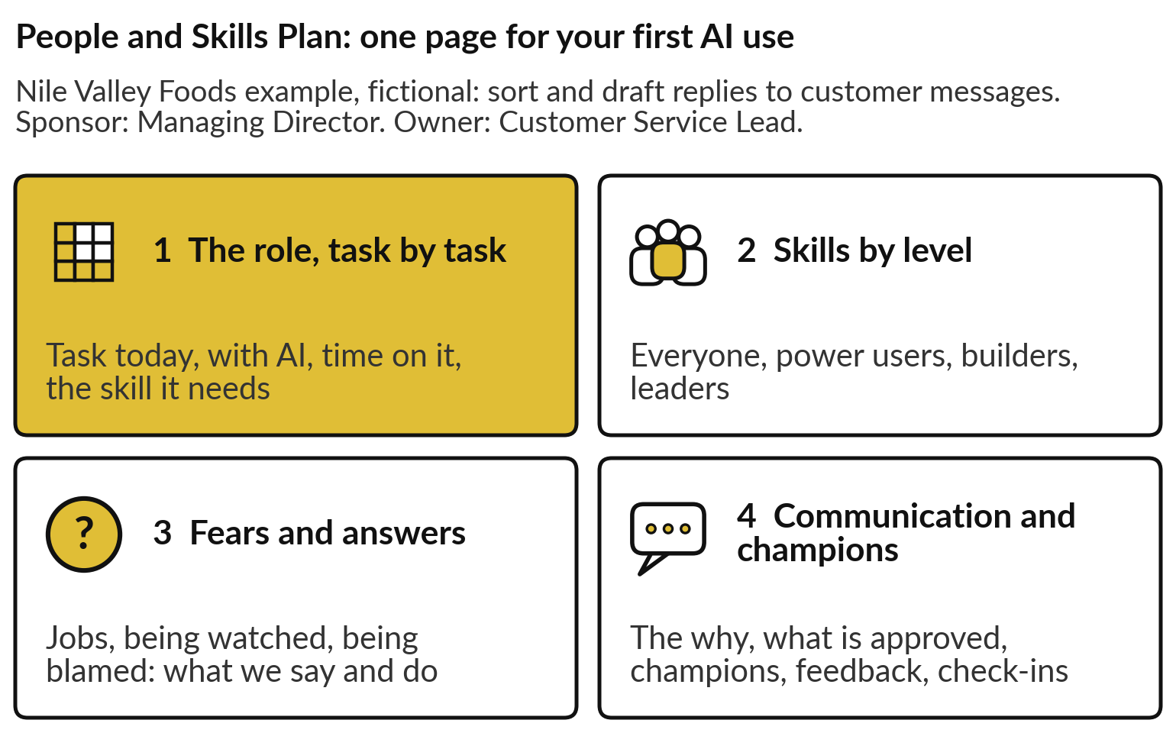
The People and Skills Plan puts the role,
skills, fears and champions on one page
One plan for the first AI use you will start.
The grey example in the template is this same case.
A sponsor and an owner sign it.
Notes:
What we just built is part one of a single page, the People and Skills Plan, in your templates folder. Part one is the role, task by task. Part two is skills by level: everyone, power users, builders and leaders. Part three is the fears and your answers, said and done.
Part four is communication and champions: the why, what is approved and what is not, the champions, how people give feedback, and the check-ins. The grey example in the template is this same Nile Valley Foods case, so you can see a finished page. A sponsor and a plan owner sign it. After a five-minute break, you write your own.

Slide 27
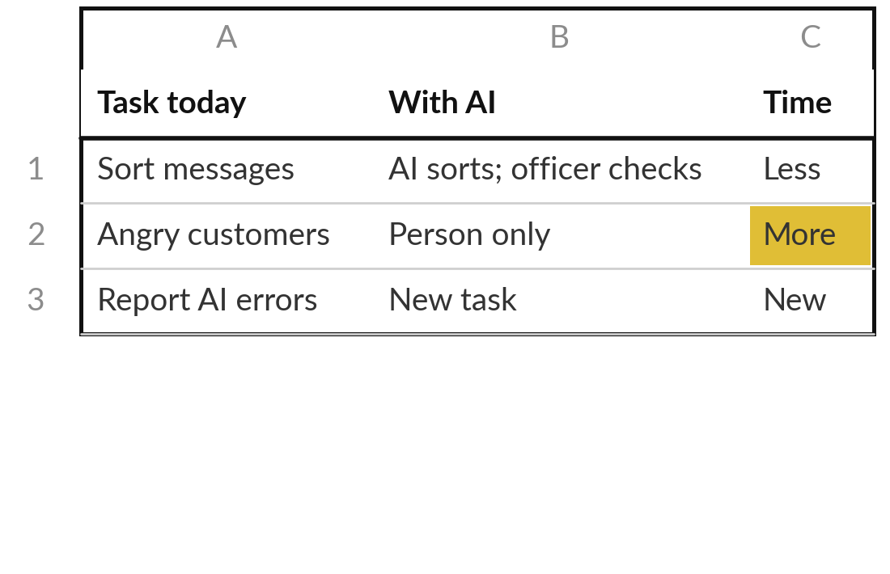
Part 1: redesign one role in
your first AI use, task by task
20 minutes
Hands-on: your own people
Take the portfolio entry you ranked first, and the role it touches most.
Open the People and Skills Plan. Write the AI use, sponsor and owner.
List every task in that role today.
For each: AI’s part, time on it, the skill it needs.
Mark the new tasks in red.
You keep: Part 1: one role, task by task.
Notes:
Welcome back. For the next hour you work on your own people, in four blocks, and I walk round. This first block is twenty minutes. Take the portfolio entry you ranked first in Session 11 and the role it touches most. Open the People and Skills Plan and write the AI use, the sponsor and the plan owner.
Then list every task in that role as it is done today, before any tool. For each task, write what the AI does, if anything, whether time on it goes up or down, and the skill it needs. Mark any new task in red. If the role has more than eight tasks, take the eight that fill most of the week.

Slide 28
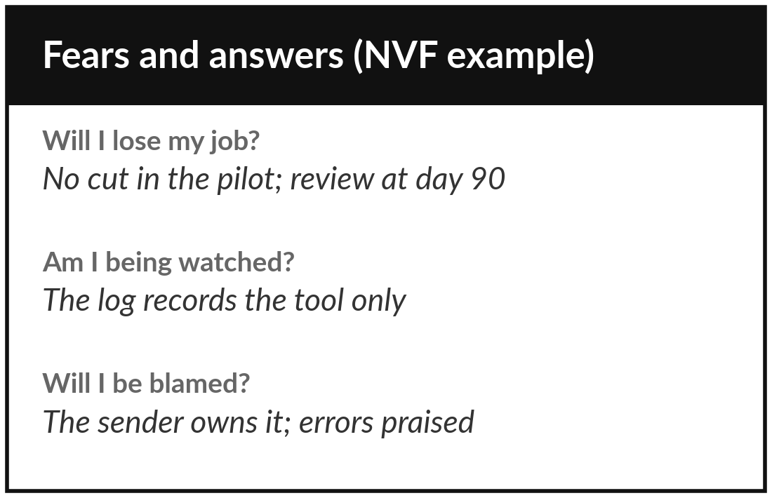
Part 2 and 3: skills by level, and
the fears with your answers
15 minutes
Hands-on: your own people
Plan the training for each level, and answer the three fears.
Part 2: what everyone, power users, builders and leaders learn, and how.
Part 3: write what you will say to each fear.
Next to it, write what you will do to prove it.
Cross out any promise you cannot keep.
You keep: Parts 2 and 3: four levels of training, three fears answered.
Notes:
Your role is redesigned, so now the people in it need skills and reassurance. Fifteen minutes. In part two, write what each level learns and how: everyone, the power users, the builders and the leaders. Name the power users if you can. In part three, write what you will say to each fear: my job, being watched, being blamed.
Next to each, write the action that proves it, such as where the freed time goes or how the log is used. Then read your answers as an anxious employee would. Cross out any promise you cannot keep, because a broken promise does more harm than silence.

Slide 29
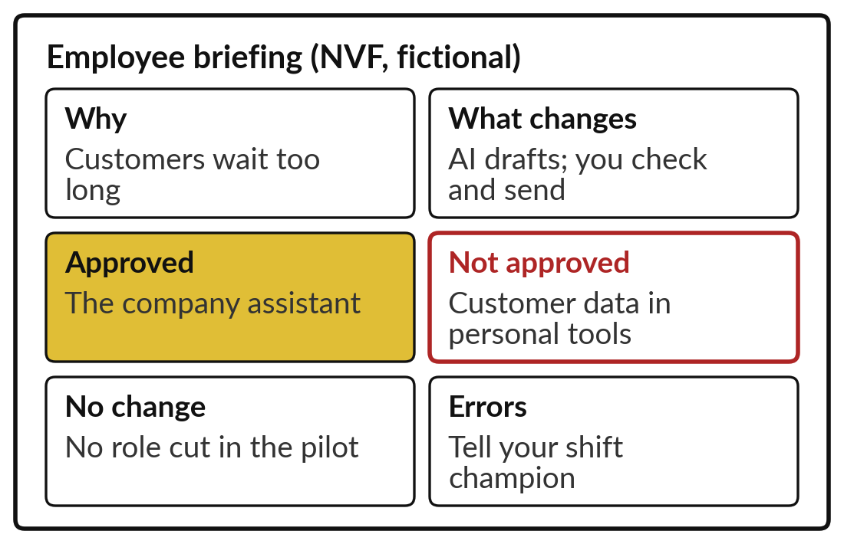
Part 4: write your employee
briefing and name your champions
15 minutes
Hands-on: your own people
Write the briefing you will give in person, and choose your champions.
The why, in one sentence.
What changes, and what does not.
Approved and not approved.
Name two champions, the feedback route and the check-ins.
You keep: Part 4 and a one-page employee briefing.
Notes:
The plan is ready, so now write what people will hear. Fifteen minutes. Start with the why, in one sentence a frontline employee would repeat to a friend. Then what changes for them, and what does not. Then what is approved and what is not, especially where customer data may go.
Then name two champions, people others trust, and write how feedback reaches you: a weekly review, an error log, check-ins at day thirty, sixty and ninety. Read your briefing aloud to your neighbour. If it takes more than two minutes, or needs a technical word, shorten it.

Slide 30
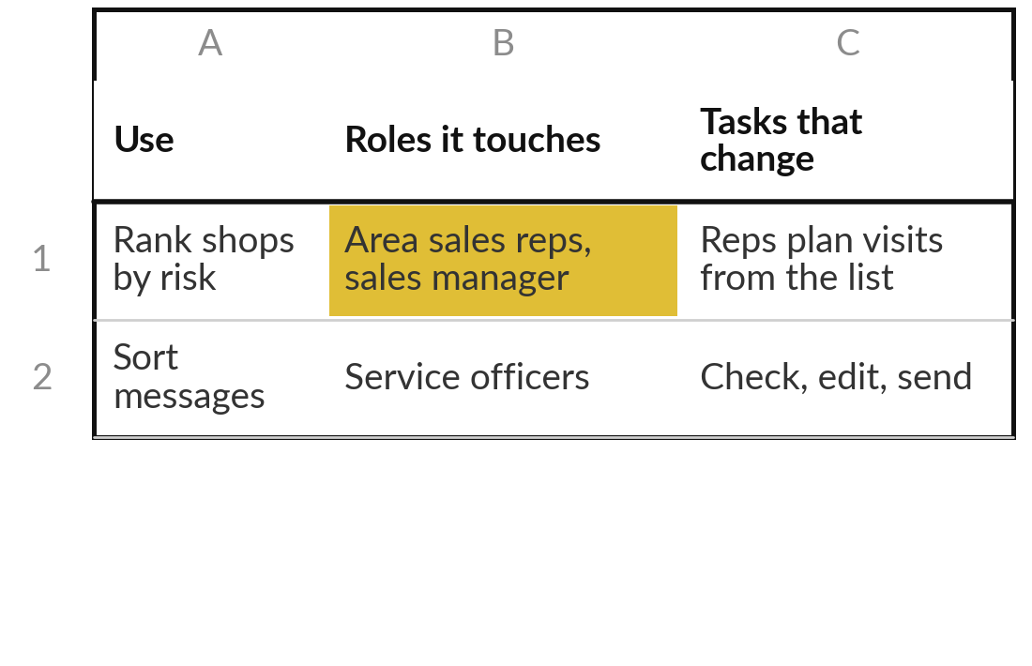
Add the people column to every entry
in your AI Opportunity Portfolio
10 minutes
Hands-on: your portfolio
For each portfolio entry, note the roles it touches and the tasks that change.
Open the sheet People, risk, data.
For each entry: roles it touches.
Then: the tasks that change.
Flag any entry where you could not yet answer the fears.
You keep: The people column filled for every entry.
Notes:
One more block, ten minutes, and it widens the view to your whole portfolio. Open the AI Opportunity Portfolio, sheet People, risk, data. For every entry, write the roles it touches and the tasks that change, in a few words. You did the first entry in depth; the others need only a line each.
If an entry touches a role whose fears you could not yet answer, flag it. That flag matters in Session 14, when you choose what to start in the next ninety days. The risk columns on the same sheet wait for Session 13.

Slide 31




Choose a route for bringing your
people in, and a date for the briefing
Which route fits your organisation for the first use?
Train first
Volunteers
Redesign roles
Not yet
Everyone learns the basics before the tool arrives, as Equity did
Champions pilot it on one shift, then the rest join
Agree the new task mix with staff and HR first
We cannot yet give the fears a true answer
Write your route, the reason and the date of your briefing in your workbook.
Notes:
You have a plan and a briefing, so now one decision. How will you bring your people into your first AI use?
Train first, if everyone needs the basics before any tool arrives, as Equity did. Volunteers, if champions should pilot it on one shift while the rest watch the results. Redesign roles, if the new mix of tasks should be agreed with staff and HR before anything starts. Or not yet, if you cannot yet give a true answer to the fears; that is a sound decision, and your first task is to find the answer.
Say your route and the date of your briefing aloud, then write them down.

Slide 32
Plan for people task by task, and
keep every promise you make them
The job stays; its mix of tasks changes.
Answer the three fears out loud.
Train by level, everyone first.
Brief people yourself, then give champions a role.
Notes:
We end on the officer’s six tasks, because the session comes back to them. Look at tasks first, because jobs change task by task. AI augments a task, automates it or creates new ones, and exposed means affected. Answer the three fears out loud and keep every promise; Commonwealth Bank paid for deciding before it understood the work.
Train by level, from everyone to the leaders who read the results. And tell people the why, what is approved and what is not, then give champions a role. Klarna, Equity and Duolingo showed three routes, and the one you choose is now written in your plan.

Slide 33
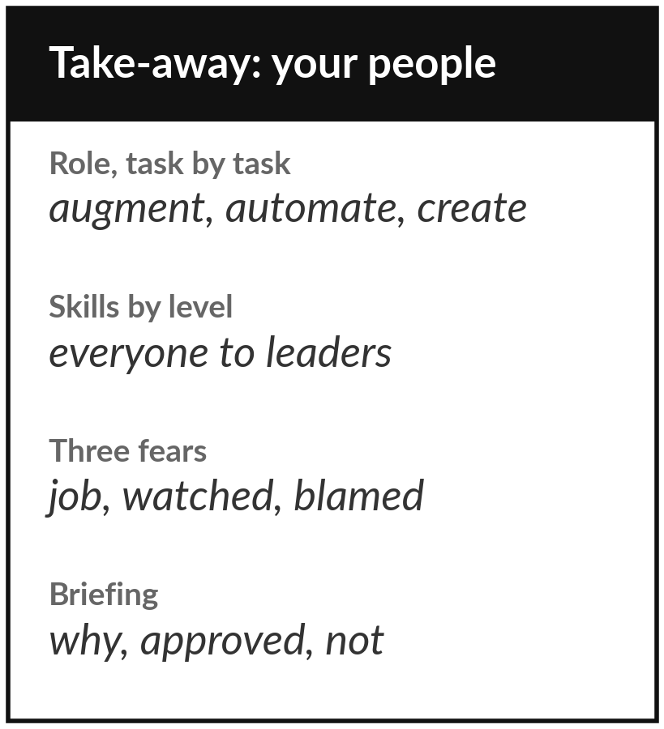
Keep your People and Skills Plan,
and brief your team this month
What you keep from today
Your People and Skills Plan for your first AI use, the employee briefing, and the people column of your AI Opportunity Portfolio.
Our question today
What happens to my employees when AI arrives, and how do I bring them with me?
Next session
Session 13: Governance and buying: policy, risk register and vendors.
Notes:
So you leave with three things in hand. Your People and Skills Plan: the role task by task, skills by level, the fears and your answers, and your champions. Your employee briefing, ready to say aloud. And the people column of your portfolio. Brief your team this month, before any tool arrives, and keep only the promises you can keep.
In Session 13 we write the rules around it: the use policy, the risk register and the vendor checks.
We began with this question: What happens to my employees when AI arrives, and how do I bring them with me? Before you go, say in one sentence what you can now say about it.

